Slide 1




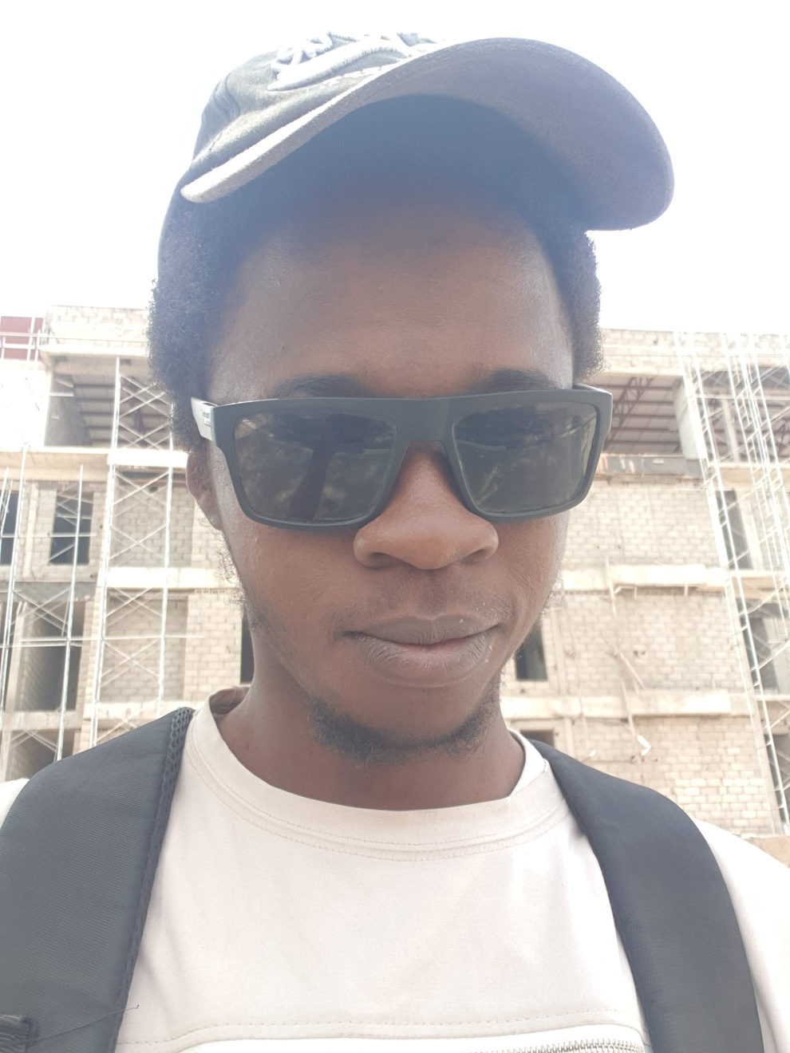
AI-POWERED RESUMES THAT GET NOTICED. THE RESUMATIC STORY
AI-POWERED RESUMES THAT GET NOTICED
SOLVING RESUME REJECTION WITH
RESUMATIC
Presented by: Suleiman Abdulkadir
Fellow ID: FE/23/22599501
Cohort 3

Slide 2

The Resume Struggle in Africa
Many students and job seekers across Nigeria and Africa face repeated rejections in the job market due to poorly structured resumes that don’t meet hiring standards.
BASED ON RECENT RECRUITMENT DATA, OVER 70% OF RESUMES ARE REJECTED BY AUTOMATED SYSTEMS BEFORE EVER REACHING A HUMAN RECRUITER.
STUDENTS LACK GUIDANCE AND EXPOSURE TO HIRING TECH LIKE ATS.
HIGH COSTS OF PREMIUM RESUME SERVICES.
LACK OF ACCESS TO QUALITY RESUME TOOLS.

Slide 3
Why Resumes Get Rejected
Key Mistakes Job Seekers Make:
USING THE SAME RESUME FOR EVERY JOB.
STUDENTS LACK GUIDANCE AND EXPOSURE TO HIRING TECH LIKE ATS.
POOR FORMATTING AND LAYOUT.
NOT TAILORING SKILLS TO JOB DESCRIPTIONS.
IRRELEVANT OR GENERIC CONTENT.
LACK OF MEASURABLE ACHIEVEMENTS.
FUN FACT: HIRING MANAGERS SPEND ONLY 6–8 SECONDS SCANNING A RESUME.

Slide 4
Understanding ATS (Applicant Tracking Systems)
What is ATS? ATS (Applicant Tracking System) is software used by companies to automatically screen and filter resumes.
How It Works:
PARSES RESUMES TO EXTRACT KEYWORDS.
COMPARES RESUME CONTENT TO JOB DESCRIPTION.
RANKS CANDIDATES BASED ON KEYWORD MATCH AND STRUCTURE.
PROBLEM: MOST STUDENTS DON’T EVEN KNOW THEIR RESUMES ARE BEING FILTERED BY MACHINES BEFORE HUMANS.

Slide 5

HOW Job
Applications Work
Stages of a Job Application:
ONLINE SUBMISSION TO A COMPANY PORTAL OR LINKEDIN.
RESUME IS SCANNED BY ATS.
IF THE RESUME MATCHES ENOUGH KEYWORDS, IT’S PASSED TO HR.
HR SHORTLISTS FOR INTERVIEWS.
KEY INSIGHT: IF YOUR RESUME FAILS THE ATS, YOUR APPLICATION IS NEVER SEEN BY A PERSON.

Slide 6
What Makes ResuMatic Special?
BUILT TO PASS ATS SCREENING
DOWNLOADABLE PDF AND SHAREABLE LINKS
AI-ENHANCED EXPERIENCE WITH GUIDED WRITING TIPS
SIMPLE UI – DESIGNED FOR MOBILE AND DESKTOP
SUPPORTS KEY SECTIONS: SKILLS, PROJECTS, EXPERIENCE

Slide 7

RESUMATIC
Resumatic
Live DEMO

